Slide 1
Preserving Location Privacy

Slide 2
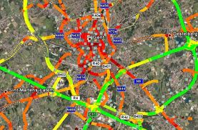
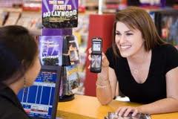
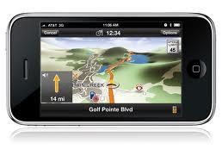
Location Based Service (LBS): Examples
Location based emergency services & traffic monitoring
  How many cars on the highway 85 north?
  What is the estimated time of travel to my destination?
  Give me the location of 5 nearest Toyota maintenance stores?
Location based advertisement & entertainment
  Send E-coupons to all customers within five miles of my store
  Where are the nearest movie theater to my current location?
Location finder
  Where are the gas stations within five miles of my location?
  Where is nearest movie theater?

Slide 3
Location privacy
The claim/right of individuals, groups and institutions to determine for themselves, when, how and to what extent location information about them is communicated to others (similar to Westin’s def)
Location privacy also refers to the ability to prevent other parties from learning one’s current or past location.

Slide 4
Privacy threats through LBS
Communication privacy threats
  Sender anonymity?
Location inference threats
  Precise location tracking
    Successive position updates can be linked together, even if identifiers are removed from location updates
  Observation identification
    If external observation is available, it can be used to link a position update to an identity (e.g., Bluetooth scanning)
  Restricted space identification
    A known location owned by identity relationship can link an update to an identity (e.g., home)

Slide 5
Location privacy architecture
Centralized trusted third party location anonymization model
  A trusted third party anonymization proxy server is served for both location updates and location anonymization.
  Capable of supporting customizable and personalized location k-anonymization
Client-based non-cooperative location anonymization model
  Mobile clients maintain their location privacy based on their knowledge
  Location cloaking without location k-anonymity support
Decentralized corporative mobility group model
  Group of mobile clients collaborate with one another to provide location privacy of a single user without involving a centralized trusted authority.
Distributed Hybrid Architecture with limited cooperation

Slide 6


A third party architecture
Assume Trusted Privacy Provider (TPP)
  Reveal location to TPP
  TPP exposes anonymized location to Loc. App (or LBS)
Loc. App1
Loc. App2
Loc. App3
Loc. App4
Privacy
Provider

Slide 7







The Location Based Service Workflow
Forward to local service:
Retrieve all available services in location
Request:
Retrieve all available services in client’s location
Reply:
Reply:
Client
Server
LBS Database
(Location Based Service)

